Slide 1

OPERATION AND METRIC
ANALYTICS
By- Abdul Gafoor

Slide 2

PROJECT DESCRIPTION:
Operation Analytics and Investigating Metric Spike
Operation Analytics is the analysis done for the complete end to end operations of a company. With the help of this, the company then finds the areas on which it must improve upon. You work closely with the ops team, support team, marketing team, etc and help them derive insights out of the data they collect.
Being one of the most important parts of a company, this kind of analysis is further used to predict the overall growth or decline of a company’s fortune. It means better automation, better understanding between cross-functional teams, and more effective workflows.
Investigating metric spike is also an important part of operation analytics as being a Data Analyst you must be able to understand or make other teams understand questions like- Why is there a dip in daily engagement? Why have sales taken a dip? Etc. Questions like these must be answered daily and for that its very important to investigate metric spike.
You are working for a company like Microsoft designated as Data Analyst Lead and is provided with different data sets, tables from which you must derive certain insights out of it and answer the questions asked by different departments.

Slide 3



APPROACH:
Firstly, go through the dataset to know more about the data, tables, columns and the rows.
Analyze the data given in the dataset to write the sql query .
Use SQL queries to get the data asked by the product manager. Write the SQL query to retrieve the data from the database/dataset in the software you are using.

Slide 4
Tech-Stack Used:
PostgreSQL server PostgreSQL documentation Pg Admin
MySQL Workbench 8.0
These software's provide better data security, more In-built functions and On demand scalability and it also provides auto completing feature which makes it easy for the developer to write the queries.

Slide 5
Insights:
While making this project I learnt about the SQL, how to implement the queries and about the various in built functions that can be used to get the data.
I got a good exposure about SQL and ProgreSQL, how SQL and the functions of ProgreSQL can be used in analysing the data from the dateset, how the queries work and are executed and how I play a major role in retrieving the data instantly without searching for it in the dataset.
You need to understand and alnalyze the dataset to write the correct query and get the results.

Slide 6
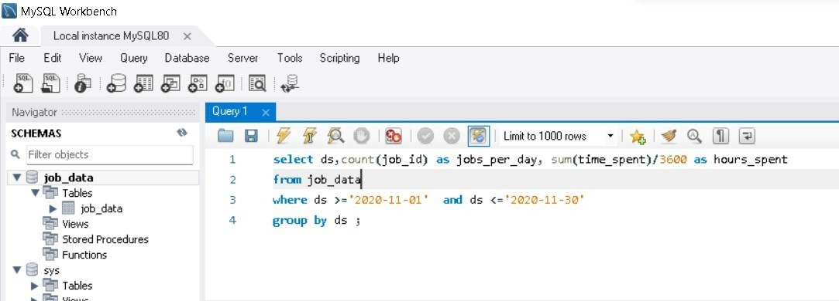
Results:
Case Study 1 : Job Data
A) Number of jobs reviewed: Amount of jobs reviewed over time.
Your task: Calculate the number of jobs reviewed per hour per day for November 2020?
Query:

Slide 7
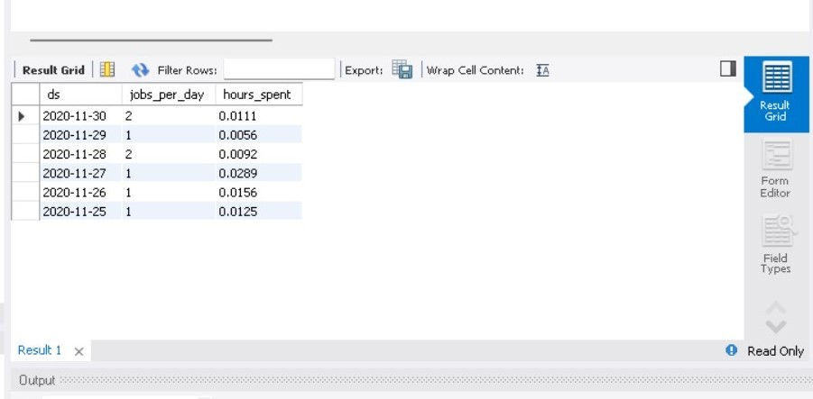
Table (output):
In this I have used sum and comparison operators in the query to get the result.

Slide 8
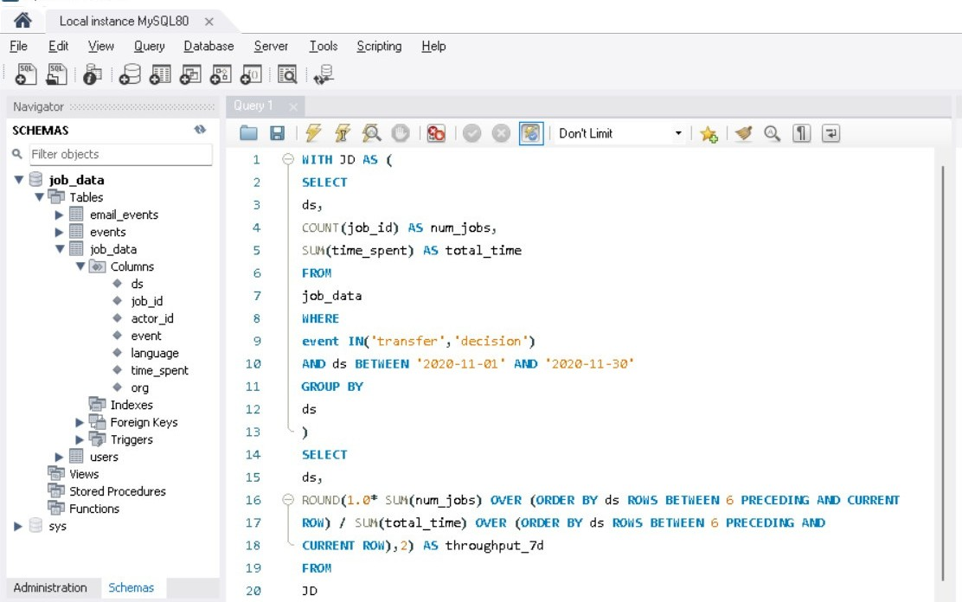
B) Throughput: It is the no. of events happening per second.
Your task: Let’s say the above metric is called throughput. Calculate 7 day rolling average of throughput? For throughput, do you prefer daily metric or 7-day rolling and why?
Query:

Slide 9
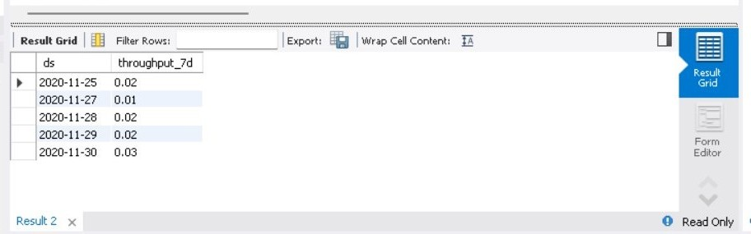
Table (output):
Here I have used ROund , SUM and With function to get the throughput.

Slide 10
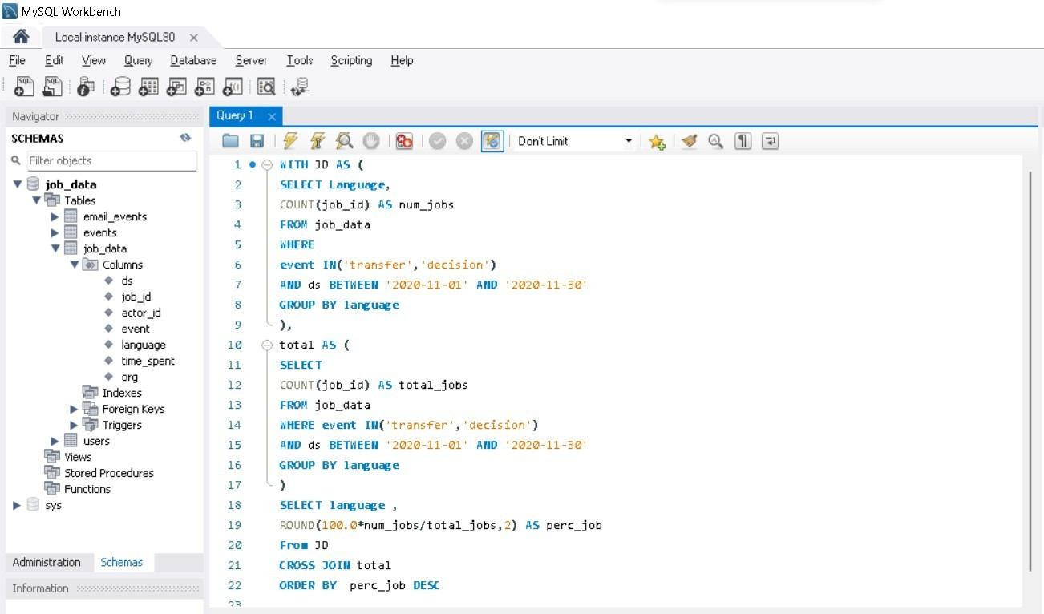
C) Percentage share of each language: Share of each language for different contents.
Your task: Calculate the percentage share of each language in the last 30 days?
Query:

Slide 11
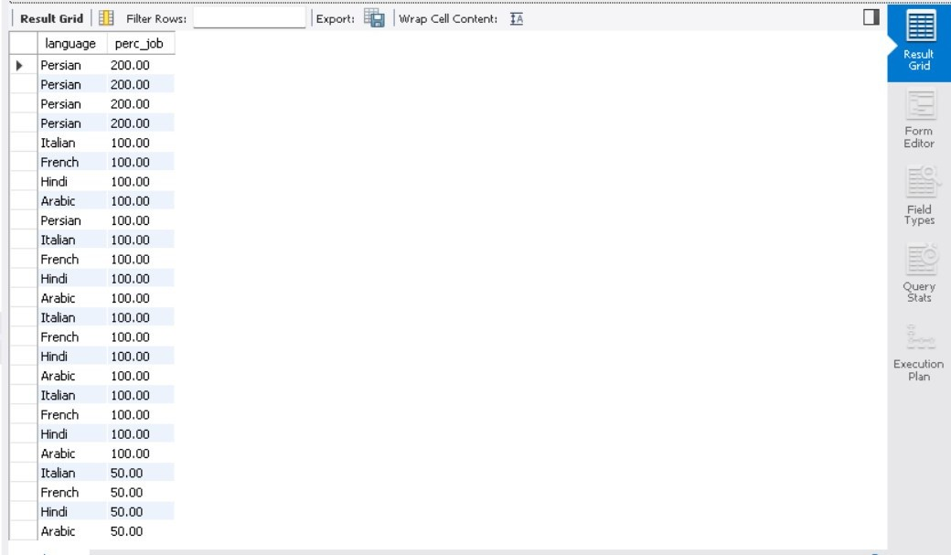
Table (output):
In this query i used , count , Round function to calculate the percentage

Slide 12
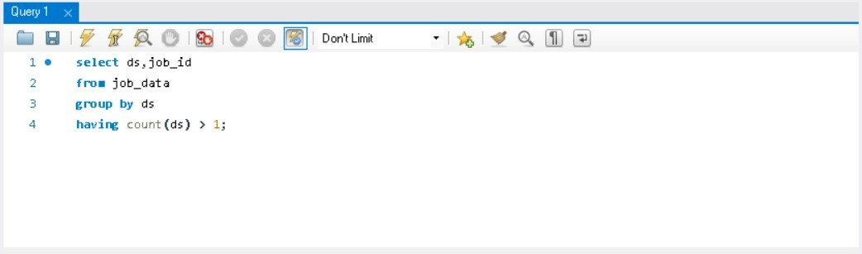
D) Duplicate rows: Rows that have the same value present in them.
Your task: Let’s say you see some duplicate rows in the data. How will you display duplicates from the table?
Query:
Here we use Count , and group by to find the duplicate rows

Slide 13
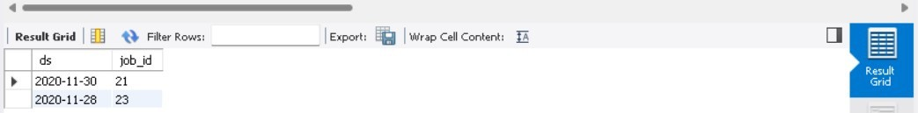
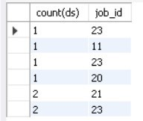
Table (output):
From the above table we can conclude that Job_id 22 and 23 have duplicate values

Slide 14
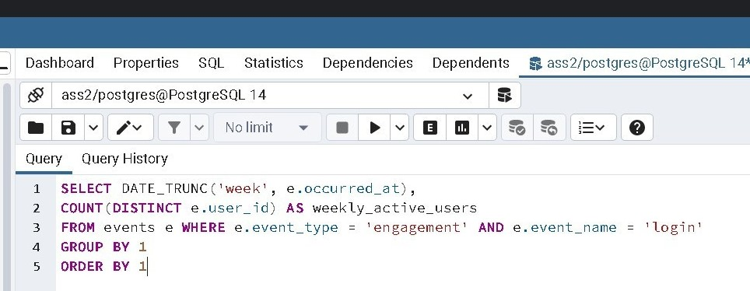
Case Study 2 : (Investigating metric spike)
A) User Engagement: To measure the activeness of a user. Measuring if the user finds quality in a product/service.
Your task: Calculate the weekly user engagement?
Query:

Slide 15
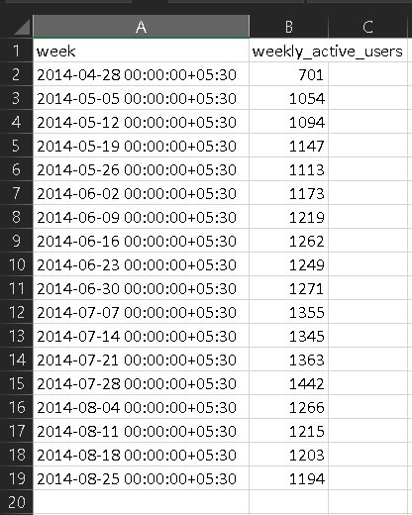
Table (output):
Here the output is extracted and downloaded in the form of csv file to make it look simpler, this feature is provided by pg Admin.

Slide 16
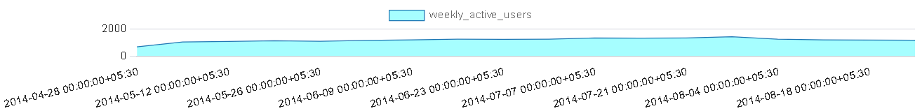
Graph:

Slide 17
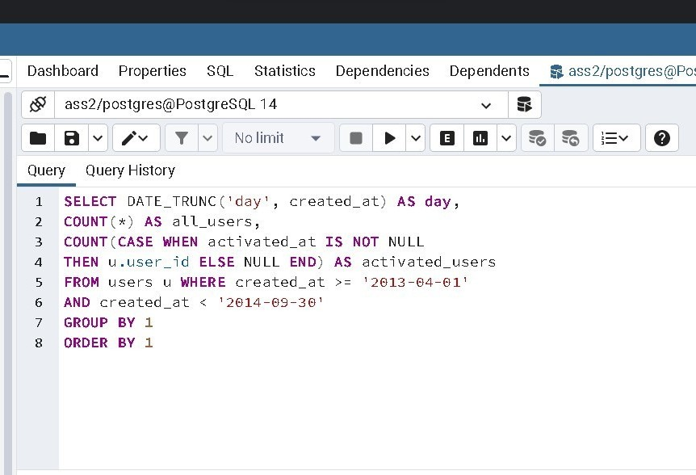
B) User Growth: Amount of users growing over time for a product.
Your task: Calculate the user growth for product?
Query:

Slide 18
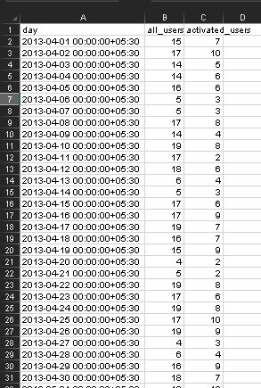
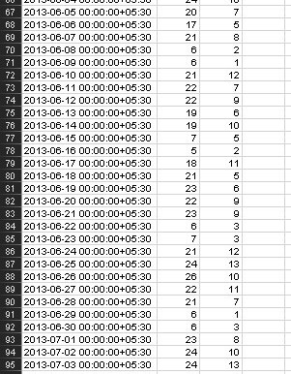
Table (output):

Slide 19
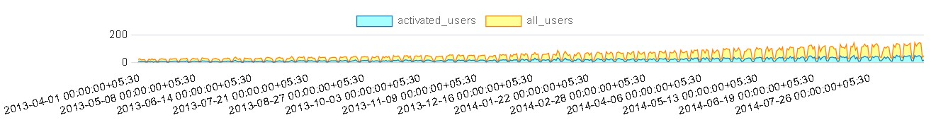
Graph:

Slide 20
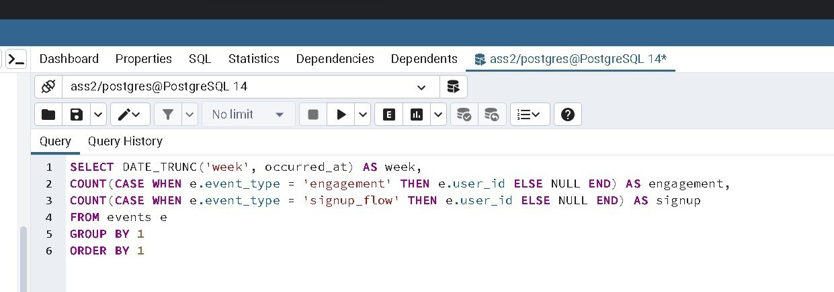
C) Weekly Retention: Users getting retained weekly after signing-up for a product.
Your task: Calculate the weekly retention of users-sign up cohort?
Query:

Slide 21
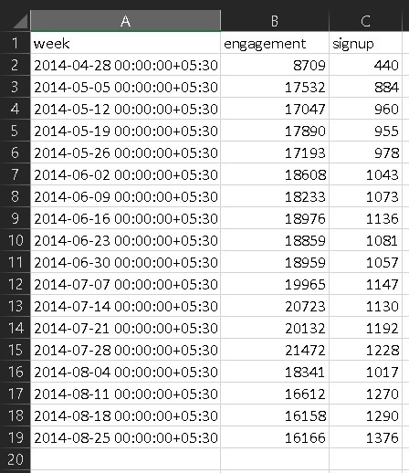
Table (output):

Slide 22
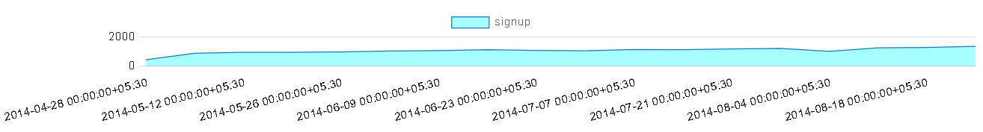
Graph:

Slide 23
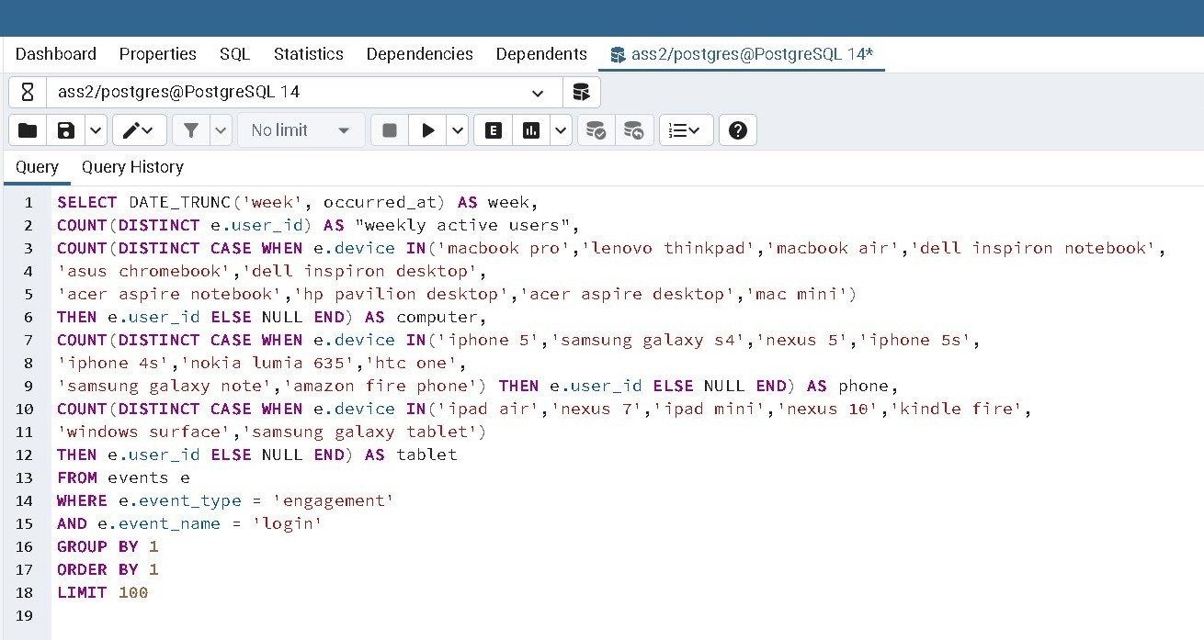
D) Weekly Engagement: To measure the activeness of a user. Measuring if the user
finds quality in a product/service weekly.
Your task: Calculate the weekly engagement per device?
Query:

Slide 24
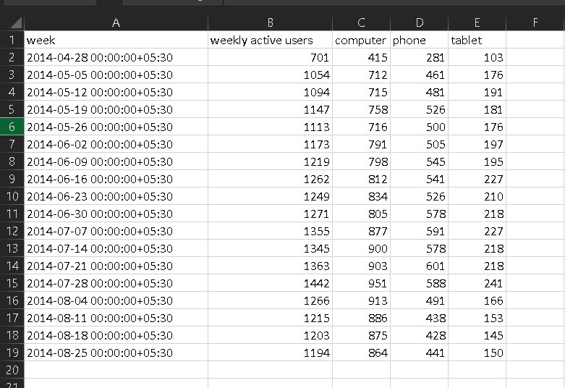
Table (output):

Slide 25
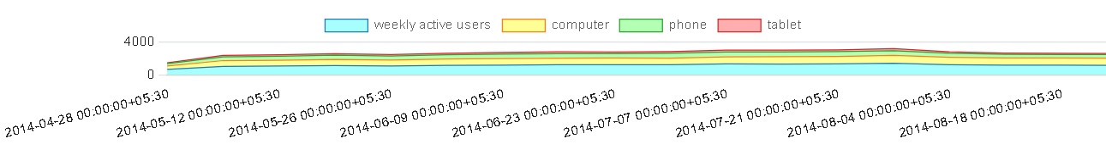
Graph:

Slide 26
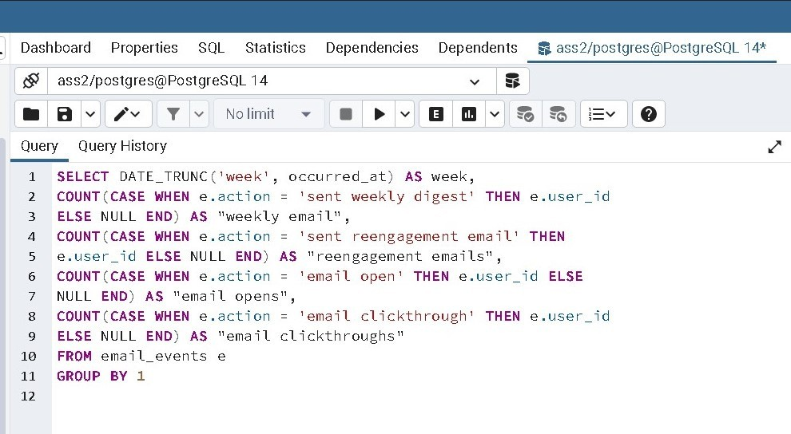
E) Email Engagement: Users engaging with the email service.
Your task: Calculate the email engagement metrics?
Query:

Slide 27
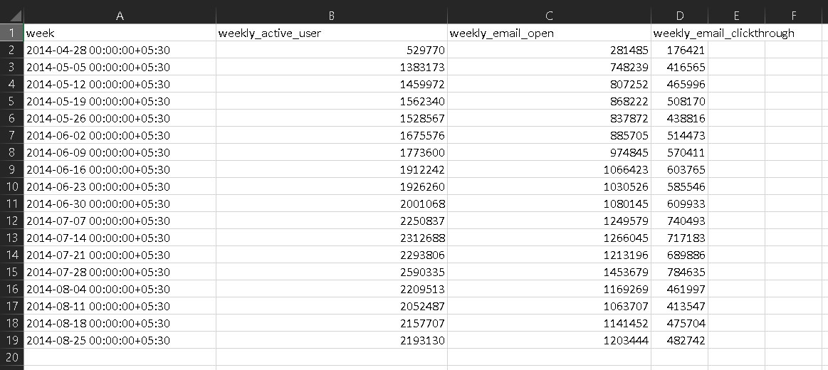
Table (output):

Slide 28
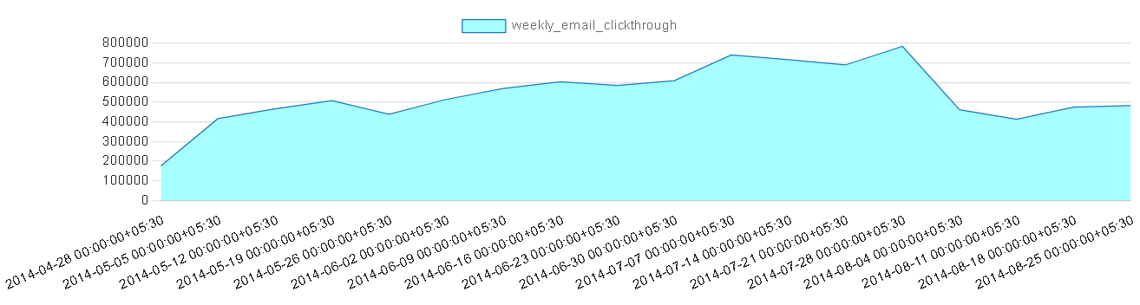
Graph:

Slide 29
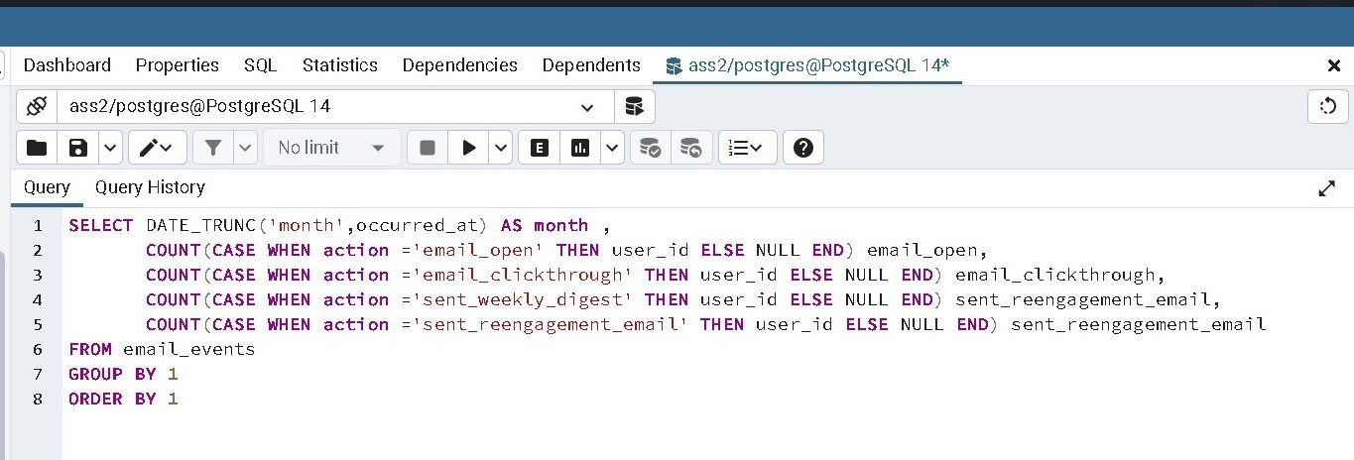
Monthly query:

Slide 30
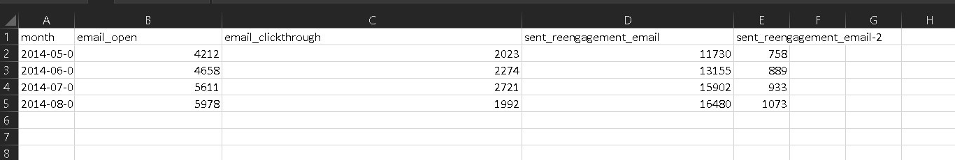
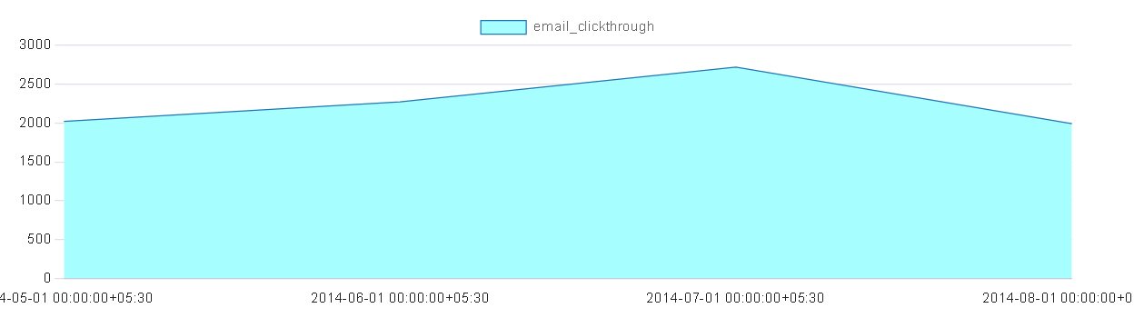
Table (output):
Graph:

Slide 31
Here we have imported the outputs in csv format so that all the values can be shown in the table , and the graph is included by using pg Admin.

Slide 32


